Slide 1
TriLab Meeting
Nicole Soltis
Kliebenstein Lab
11/30/18

Slide 2
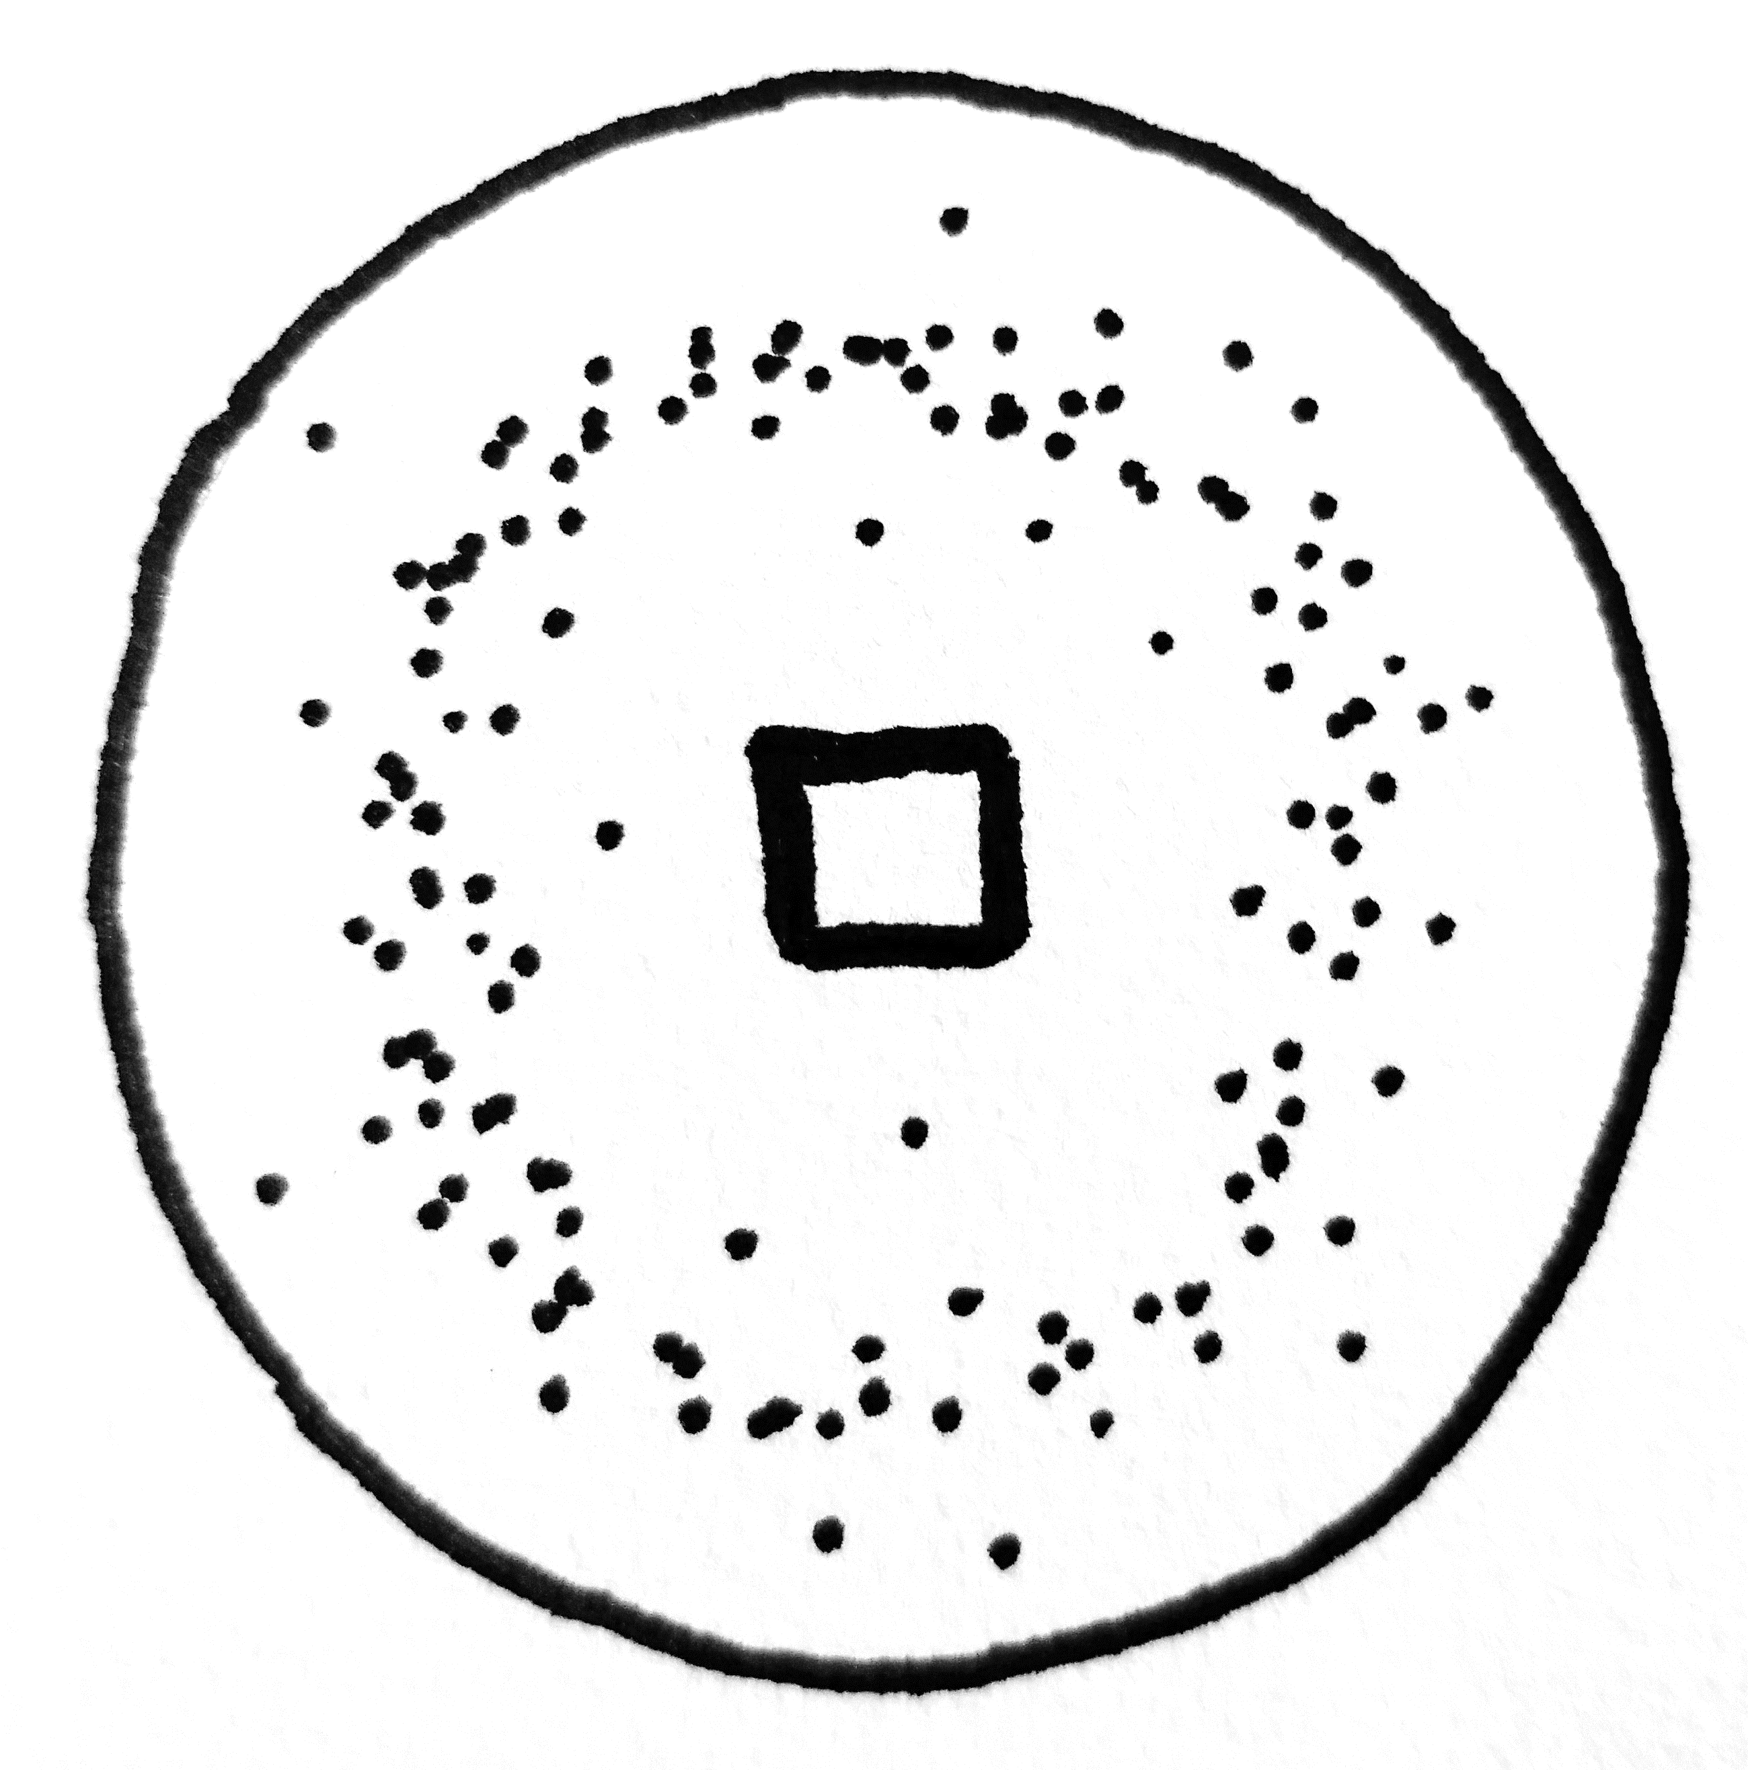

Outline
Introduction
eQTL
Cross-species eQTL
eQTL in Arabidopsis:Botrytis
Methods
Previous Results
Novel Results
Genome search for cis-eQTL
Localized search for cis-eQTL
trans-eQTL hotspots
Cross-species eQTL hotspots
Future Directions
Notes:
Move after intro. Outline exp design/ results sections
Draw out experimental design (col0/ coi1/ npr1 – color it!)

Slide 3
Introduction

Slide 4
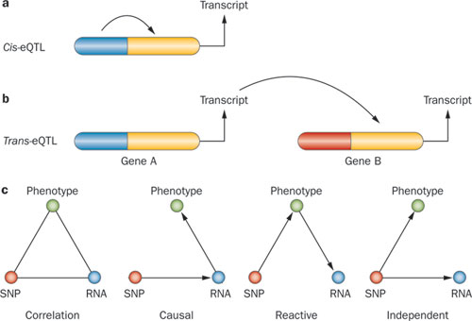
Genetic control of gene expression
MacLellan et al. 2012, Nature

Slide 5
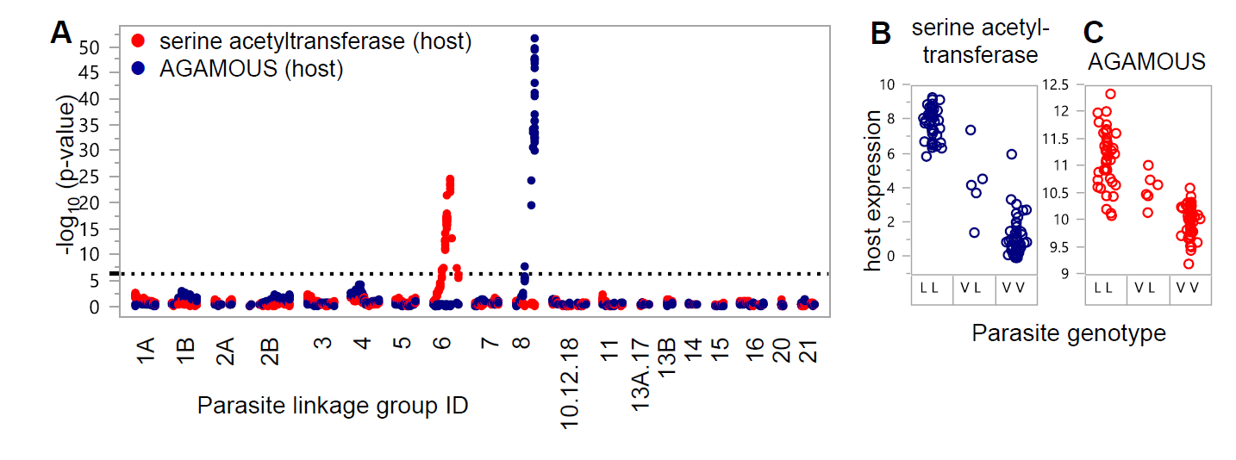
Cross-species eQTL: symbiosis of Medicago truncatula and parasitic nematode
Guo et al. 2017, Genetics
Notes:
Slide above this: eQTL in pathogen (humans)
Slide above this: biology of transcriptome x transcriptome interactions

Slide 6
Methods

Slide 7
RNAseq
95 Botrytis isolates
On Arabidopsis Col-0
(and coi-1, npr-1)
Detached leaf assay, 16 hpi
x
Notes:
Draw Bc cartoon as hyphal cluster (microscope image)
Here, show an actual photo of At and Bc (micro!)

Slide 8
GEMMA for eQTL
271,495 SNPs against the Botrytis B05.10 genome
MAF > 0.20
<20% missingness
For each of:
9267 Botrytis gene expression phenotypes
23,948 Arabidopsis gene expression phenotypes
Notes:
SNP density? Per Mb // LD – include some
Heterozygosity levels ~~ none

Slide 9
Previous Results

Slide 10
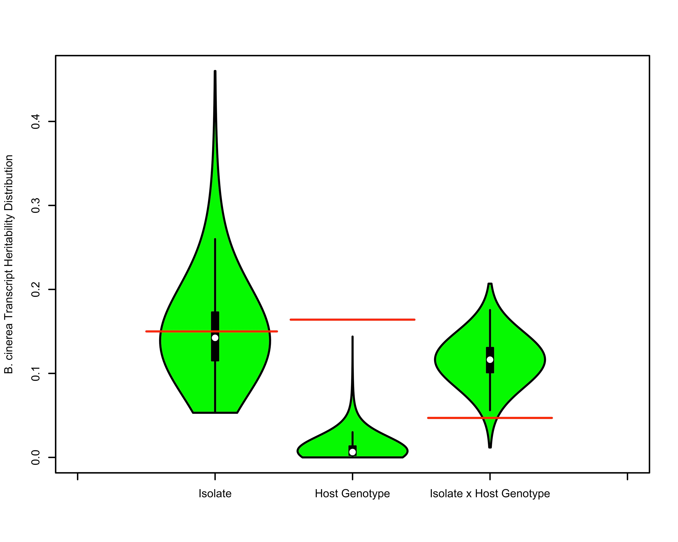
Botrytis gene expression is controlled by pathogen & host genetics
0.0 0.1 0.2 0.3 0.4
B. cinerea Transcript Heritability Distribution
Isolate Host Genotype Isolate x Host Genotype
Zhang et al. unpublished
Notes:
Host genotypes change (knockout) major defense pathways (major effects), but they are not driving the system. PATHOGEN TOO!

Slide 11
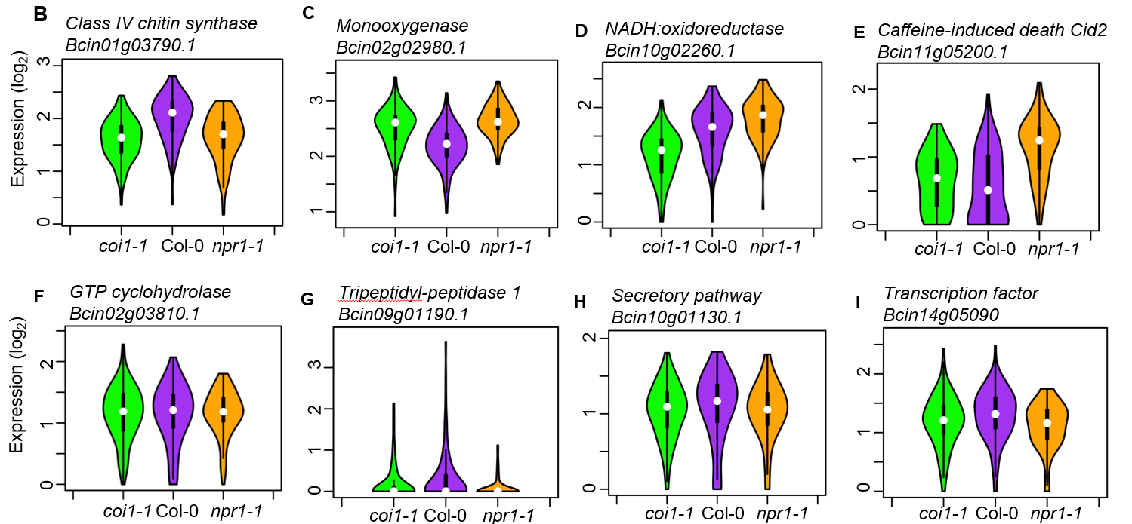
Botrytis genetic control of gene expression
Zhang et al. unpublished
Notes:
Expression profile of B. cinerea transcripts significantly influenced by host genotypes. Gene counts per transcript are normalized relative expression (log₂).
we found that the host immune system was able to alter the expression of only some of the pathogens GCNs
-- those that shift in expression depending on host genotype
natural variation in the pathogen shapes how the co-transcriptome responds to the hosts immune system.

Slide 12
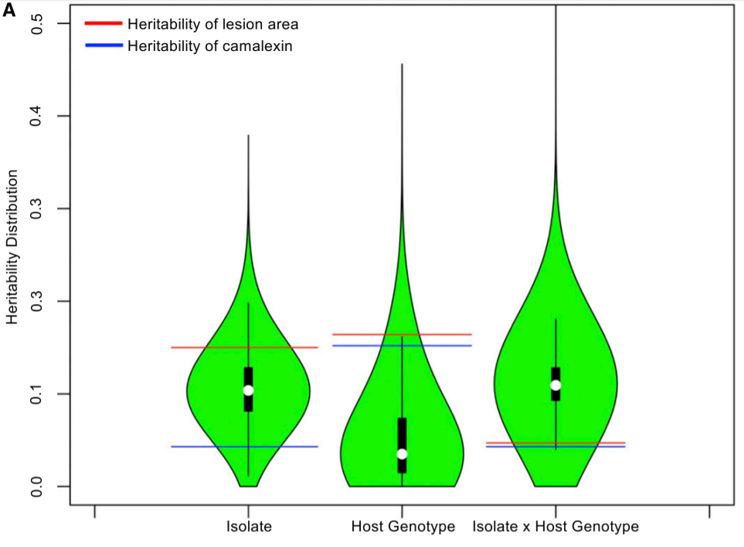
Arabidopsis gene expression is controlled by pathogen & host genetics
Zhang et al. 2017, The Plant Cell

Slide 13
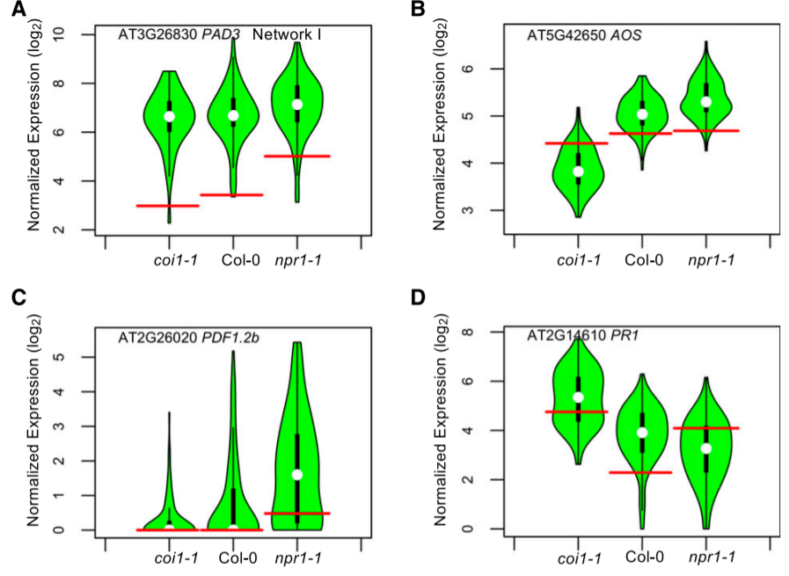
Botrytis genetic control of Arabidopsis gene expression
Zhang et al. 2017, The Plant Cell
Notes:
Plasticity in Arabidopsis defense related genes in response to B. cinerea genetic variation.
Pr1 = SA responsive
Pad3 = camalexin biosynth
PDF = JA response

Slide 14
Novel Results
Notes:
Add slide here: 1-gene GWAS. Show selecting top SNP hit. Diagram cartoon?

Slide 15
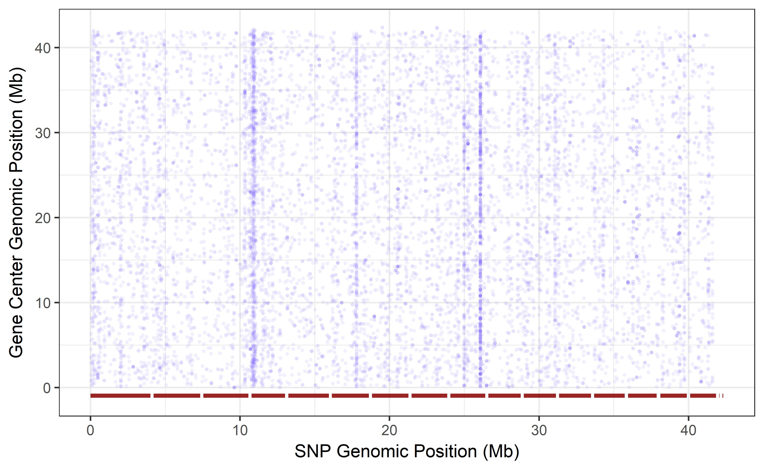
Search for cis-eQTL patterns

Slide 16
Lack of genome-wide cis-eQTL enrichment
Notes:
NOT “no cis-diag”
YES “our analysis failing to capture cis-diag”

Slide 17
Lack of observed cis effects:
Are there no major cis-effect loci for B. cinerea gene expression?
Or, did our analysis miss these cis-effects?

Slide 18
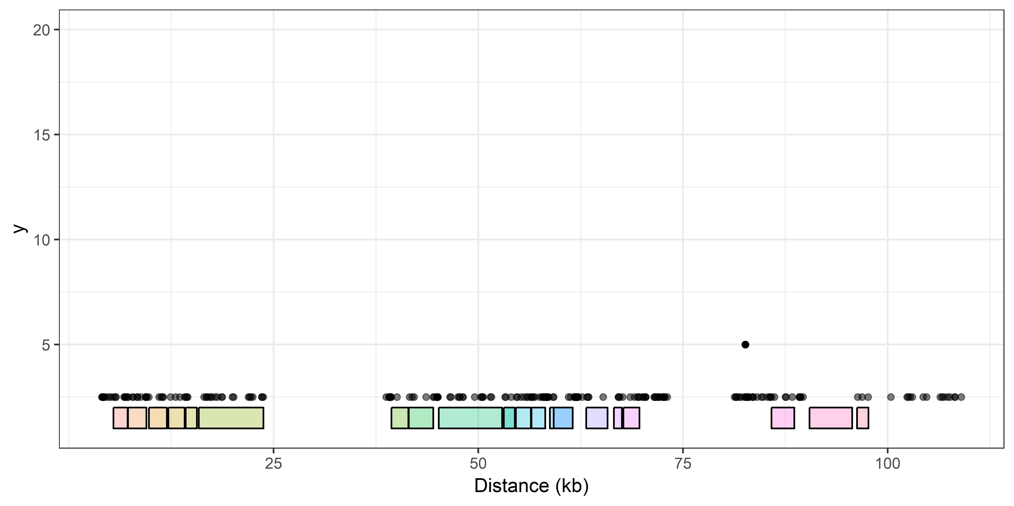
Search for cis-eQTL: Botcynic acid biosynthetic cluster
Notes:
Add a top panel: Vivian 2018 figure 5e. BOA transcriptional profile. Large fx: expect cis fx variation!

Slide 19
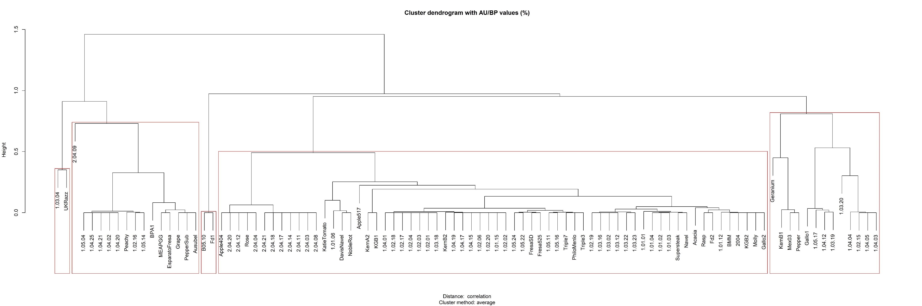
Search for cis-eQTL: Botcynic acid biosynthetic cluster
1
2
3
4
5
6
Notes:
DO NOT say “group 4 not significant”
DO SAY “massive group 5, from which group 4 outliers

Slide 20
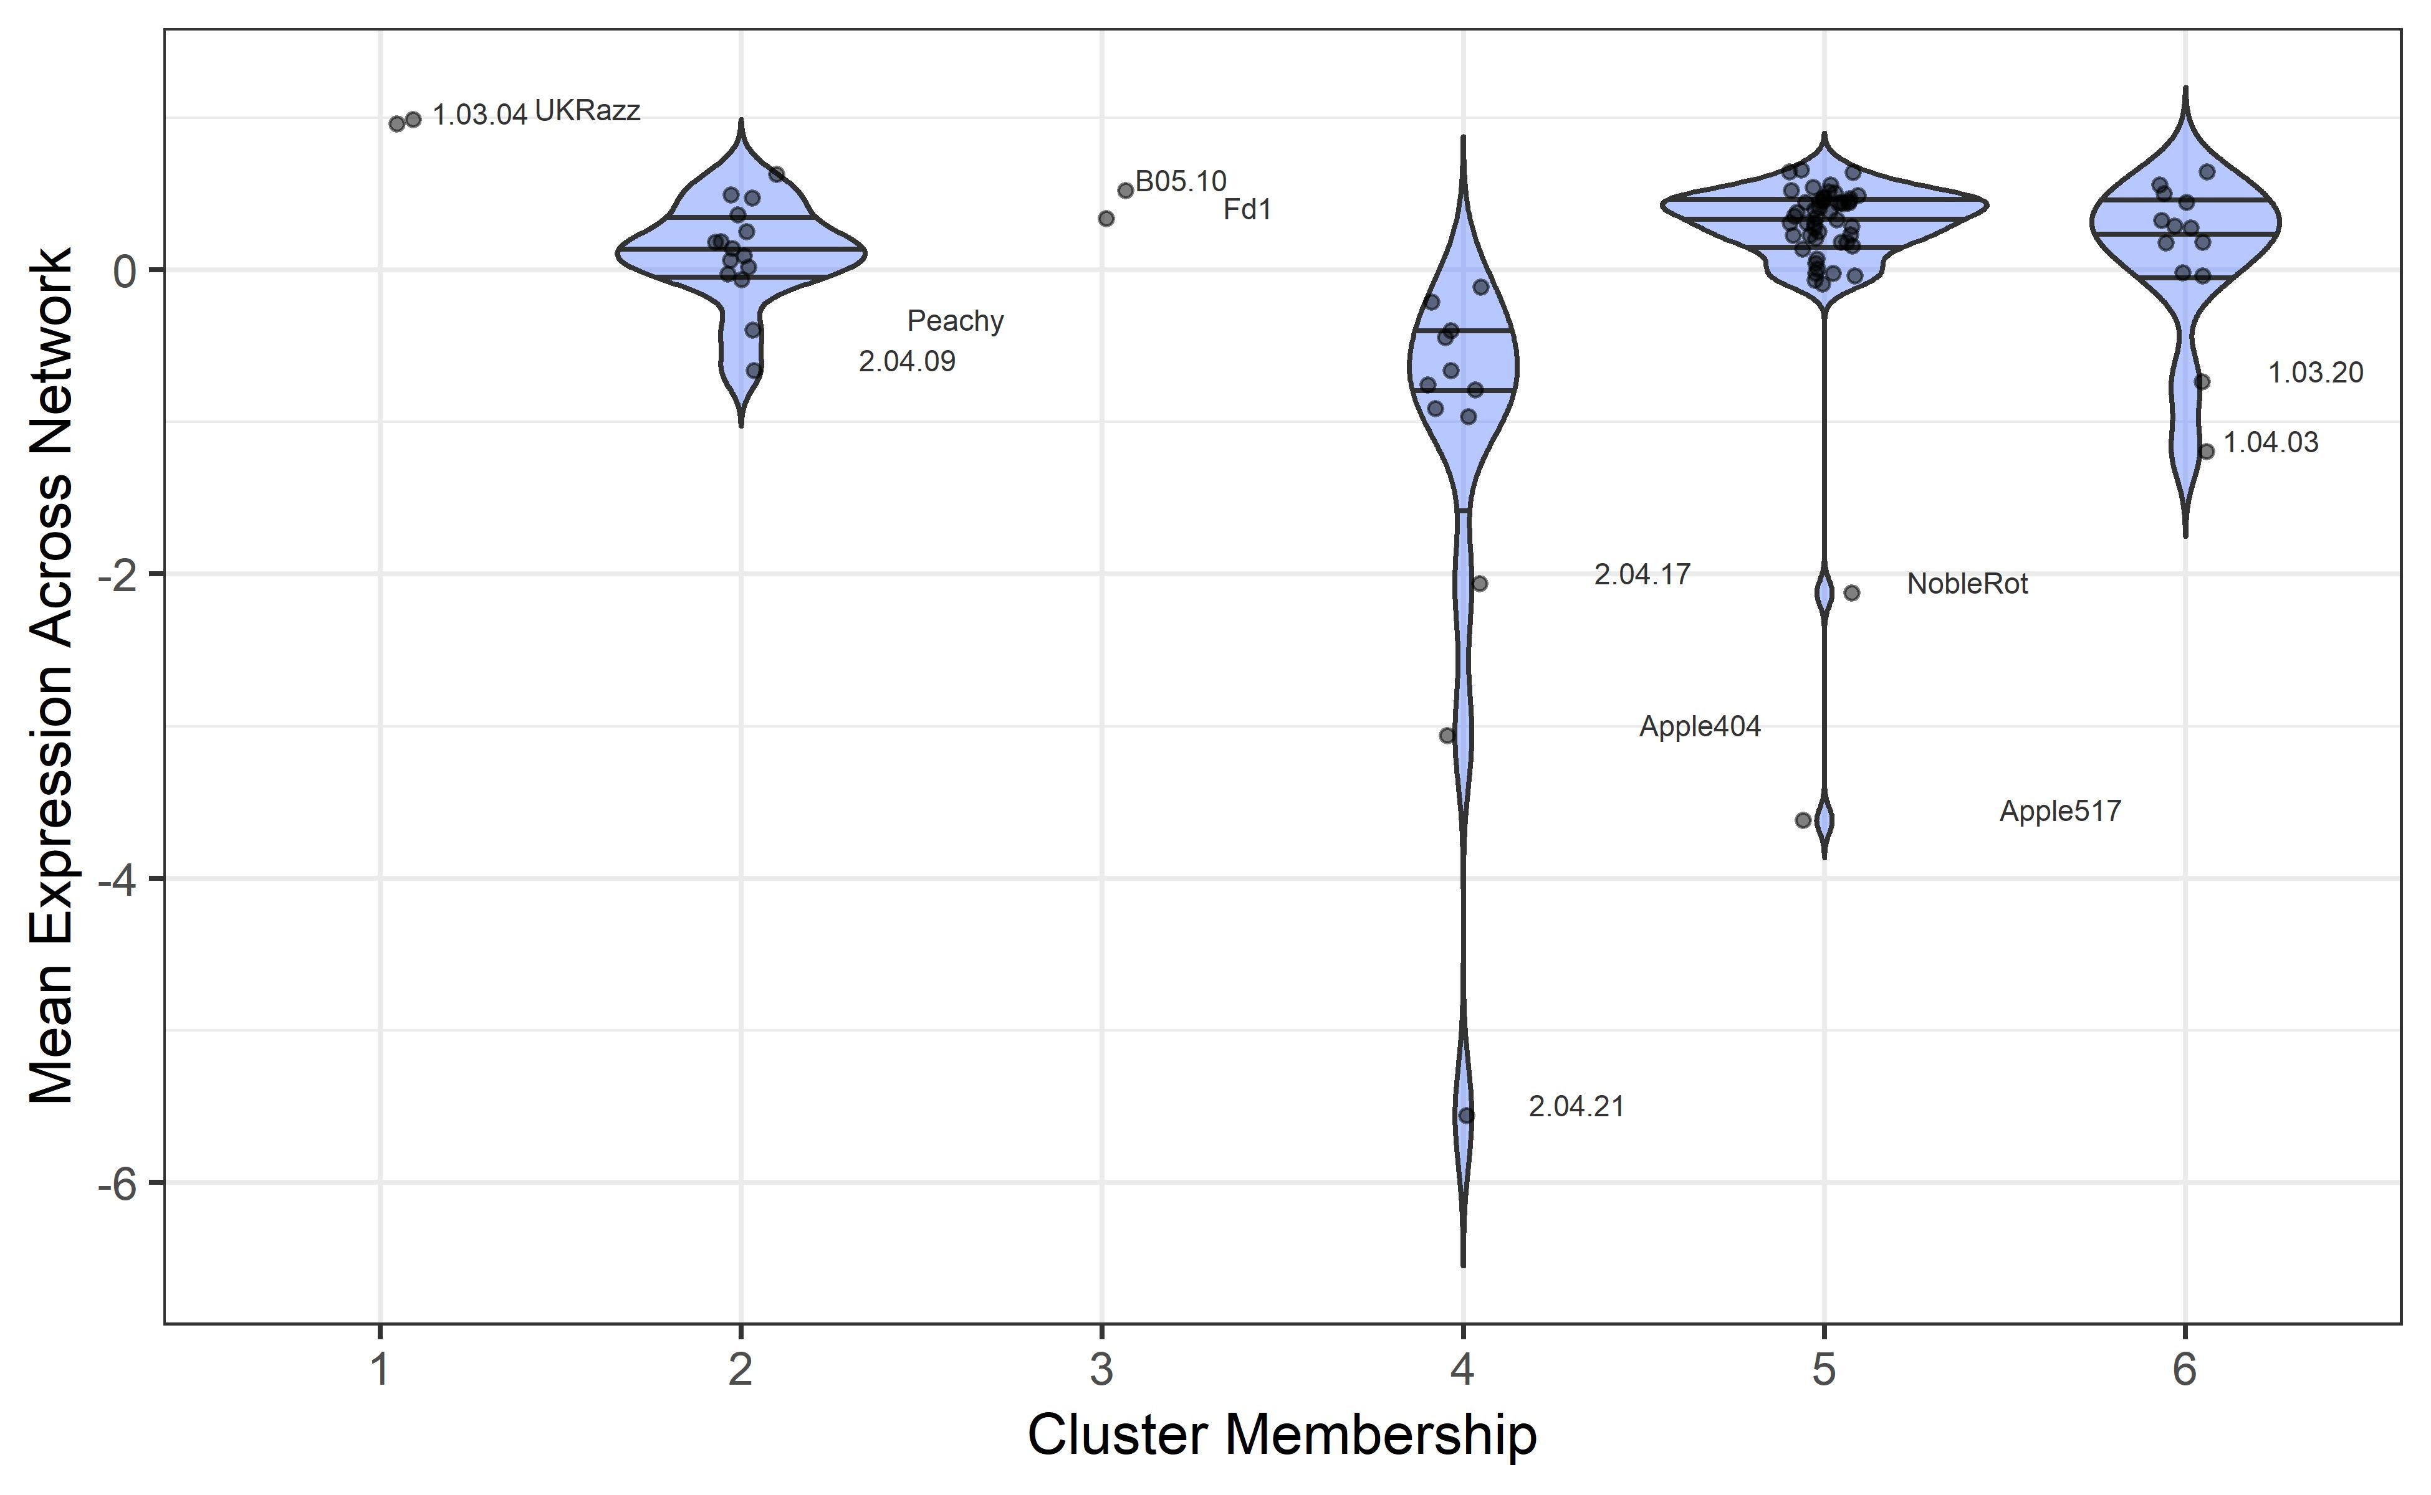
Most expression variation in BOA cluster not explained by cis-eQTL
Notes:
SNPs ~ dimodal model // GWA model “2 groups”
BUT variation splits into 6 haplotypes at this locus – true model “6 haplotypes”
DO ADD group 5, 6: low outliers. Change in expression with haplotypes other than the group 4 deletion
→ Poly haplotypery!

Slide 21
cis-acting loci may not be captured by SNP genotypes
78.6kb deletion, group 4

Slide 22
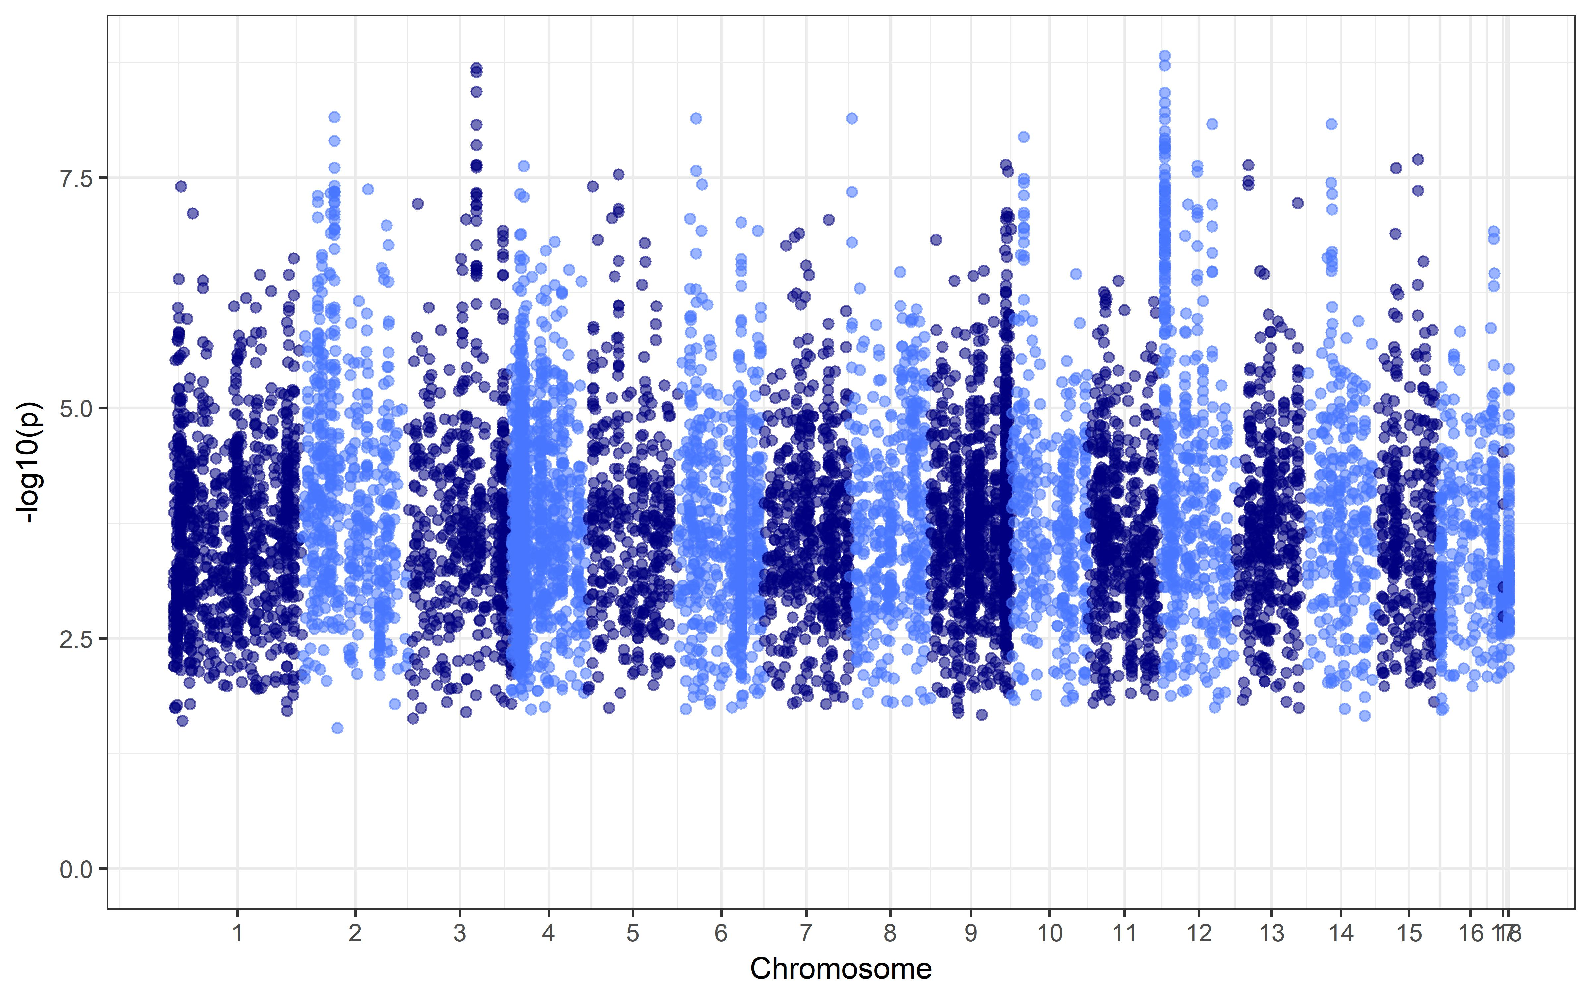
Search for eQTL hotspots: Botrytis
Notes:
Remove
INSTEAD repeat slide 16: evidence of trans hotspots!

Slide 23
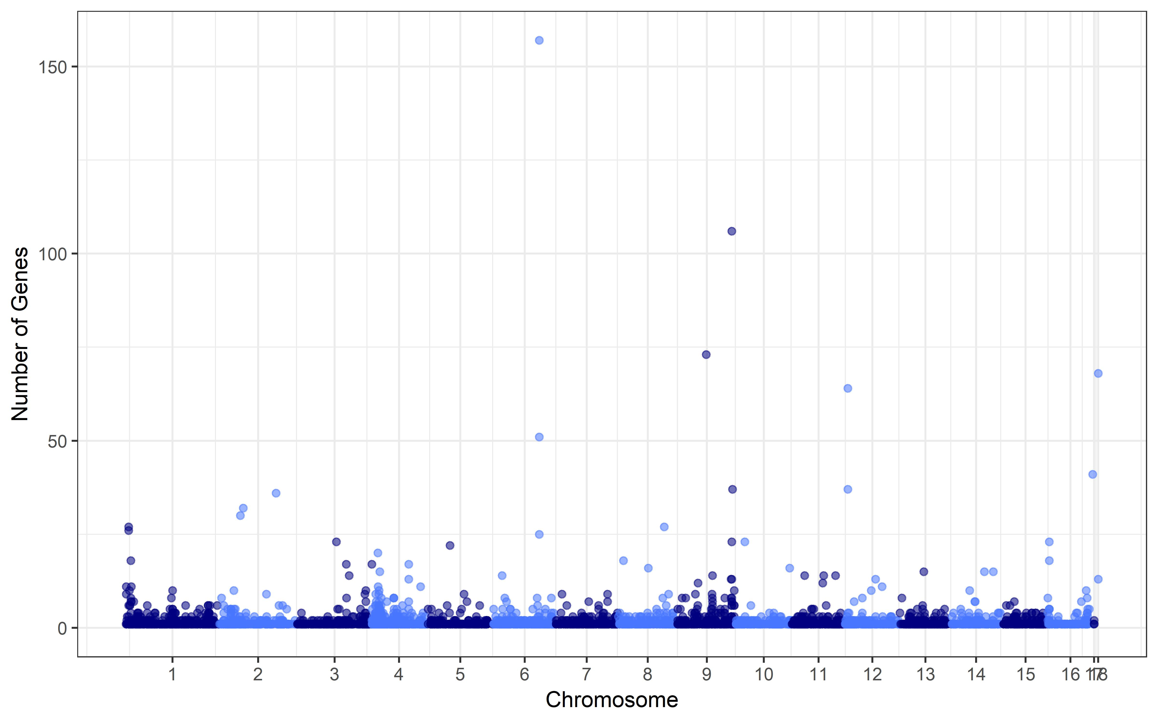
Search for eQTL hotspots: Botrytis

Slide 24
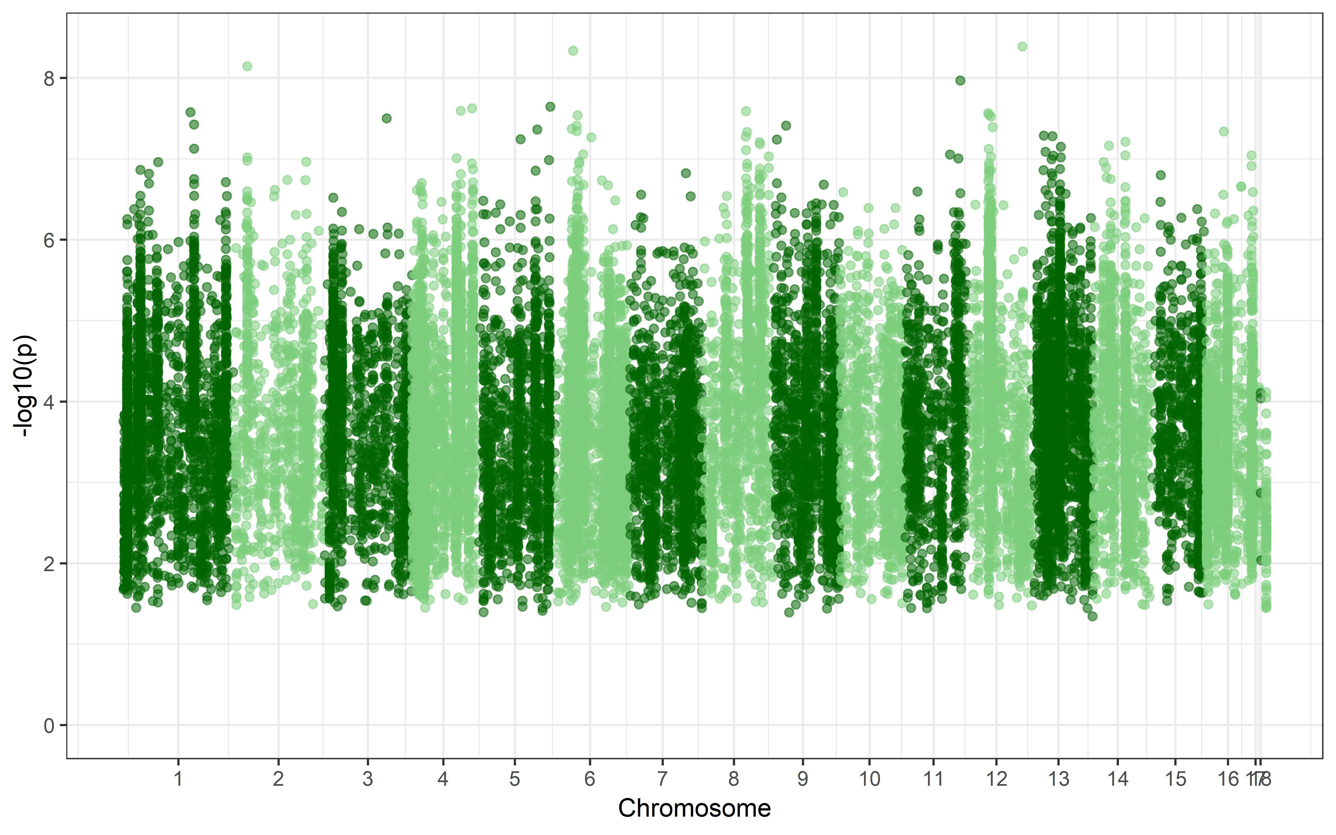
Search for cross-species eQTL hotspots: Arabidopsis

Slide 25
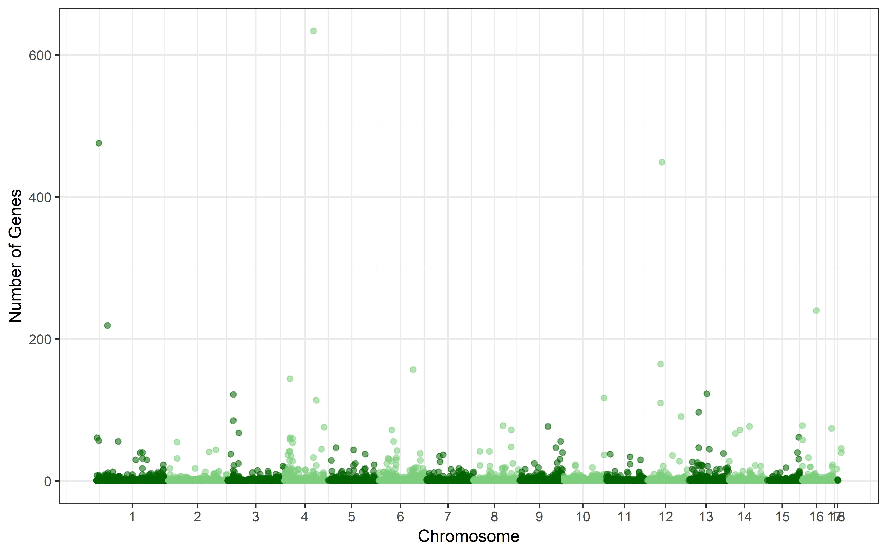
Cross-species eQTL hotspots

Slide 26
Are hotspots significant? Permuation approach
Randomized each expression profile (phenotype) 5x
For Botrytis genes
For Arabidopsis genes
Calculated minimum SNP p-value per gene for all 5 permutations
Take permutation minimum
Is minimum p-value of actual gene < random phenotype?
Is 5x permutation sufficient?
1000x permutation of 10 randomly selected gene expression phenotypes
Notes:
we are working on permutation approaches to test what is or is not a significant hotspot

Slide 27
Are hotspots significant? Simulated GEMMA approach
Random draws from genome = 271,495 SNPs
For each of:
9267 Botrytis gene expression phenotypes
23,948 Arabidopsis gene expression phenotypes
Repeat 1000x

Slide 28
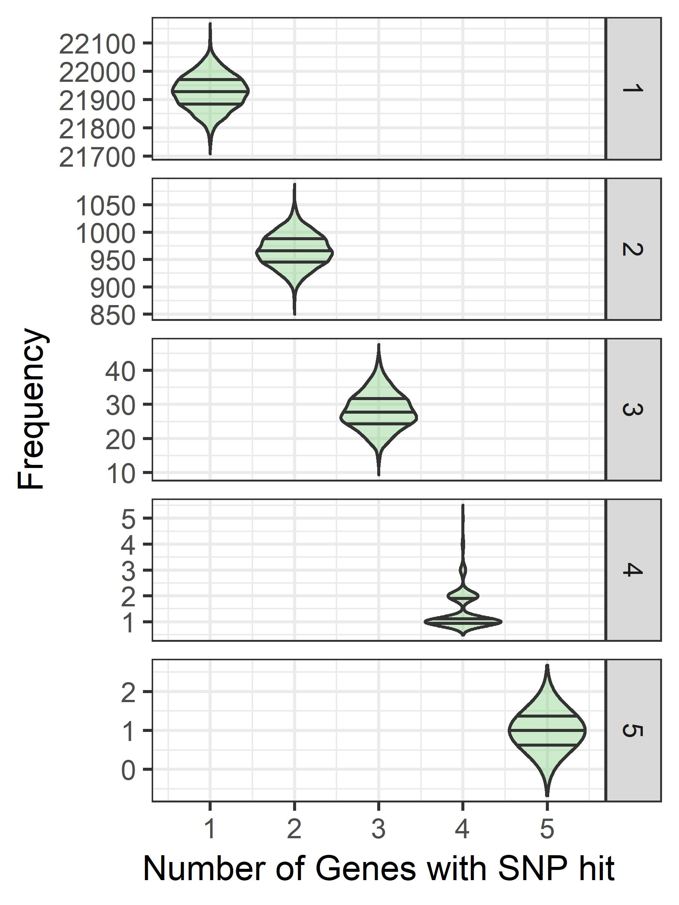
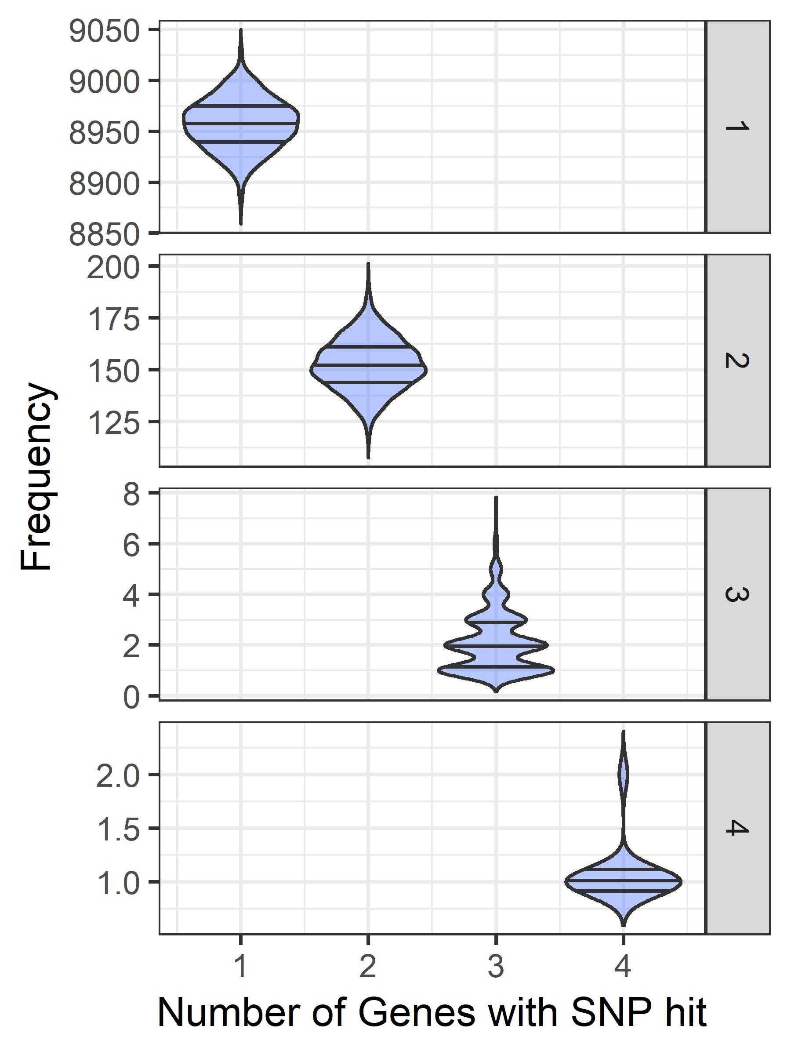
Simulated random GEMMA: size of hotspots
n=1000
n=1000
n=1000
n=1000
n=1000
n=818
n=477
n=15
n=11
Notes:
SKIP THIS. Just show threshold plot

Slide 29
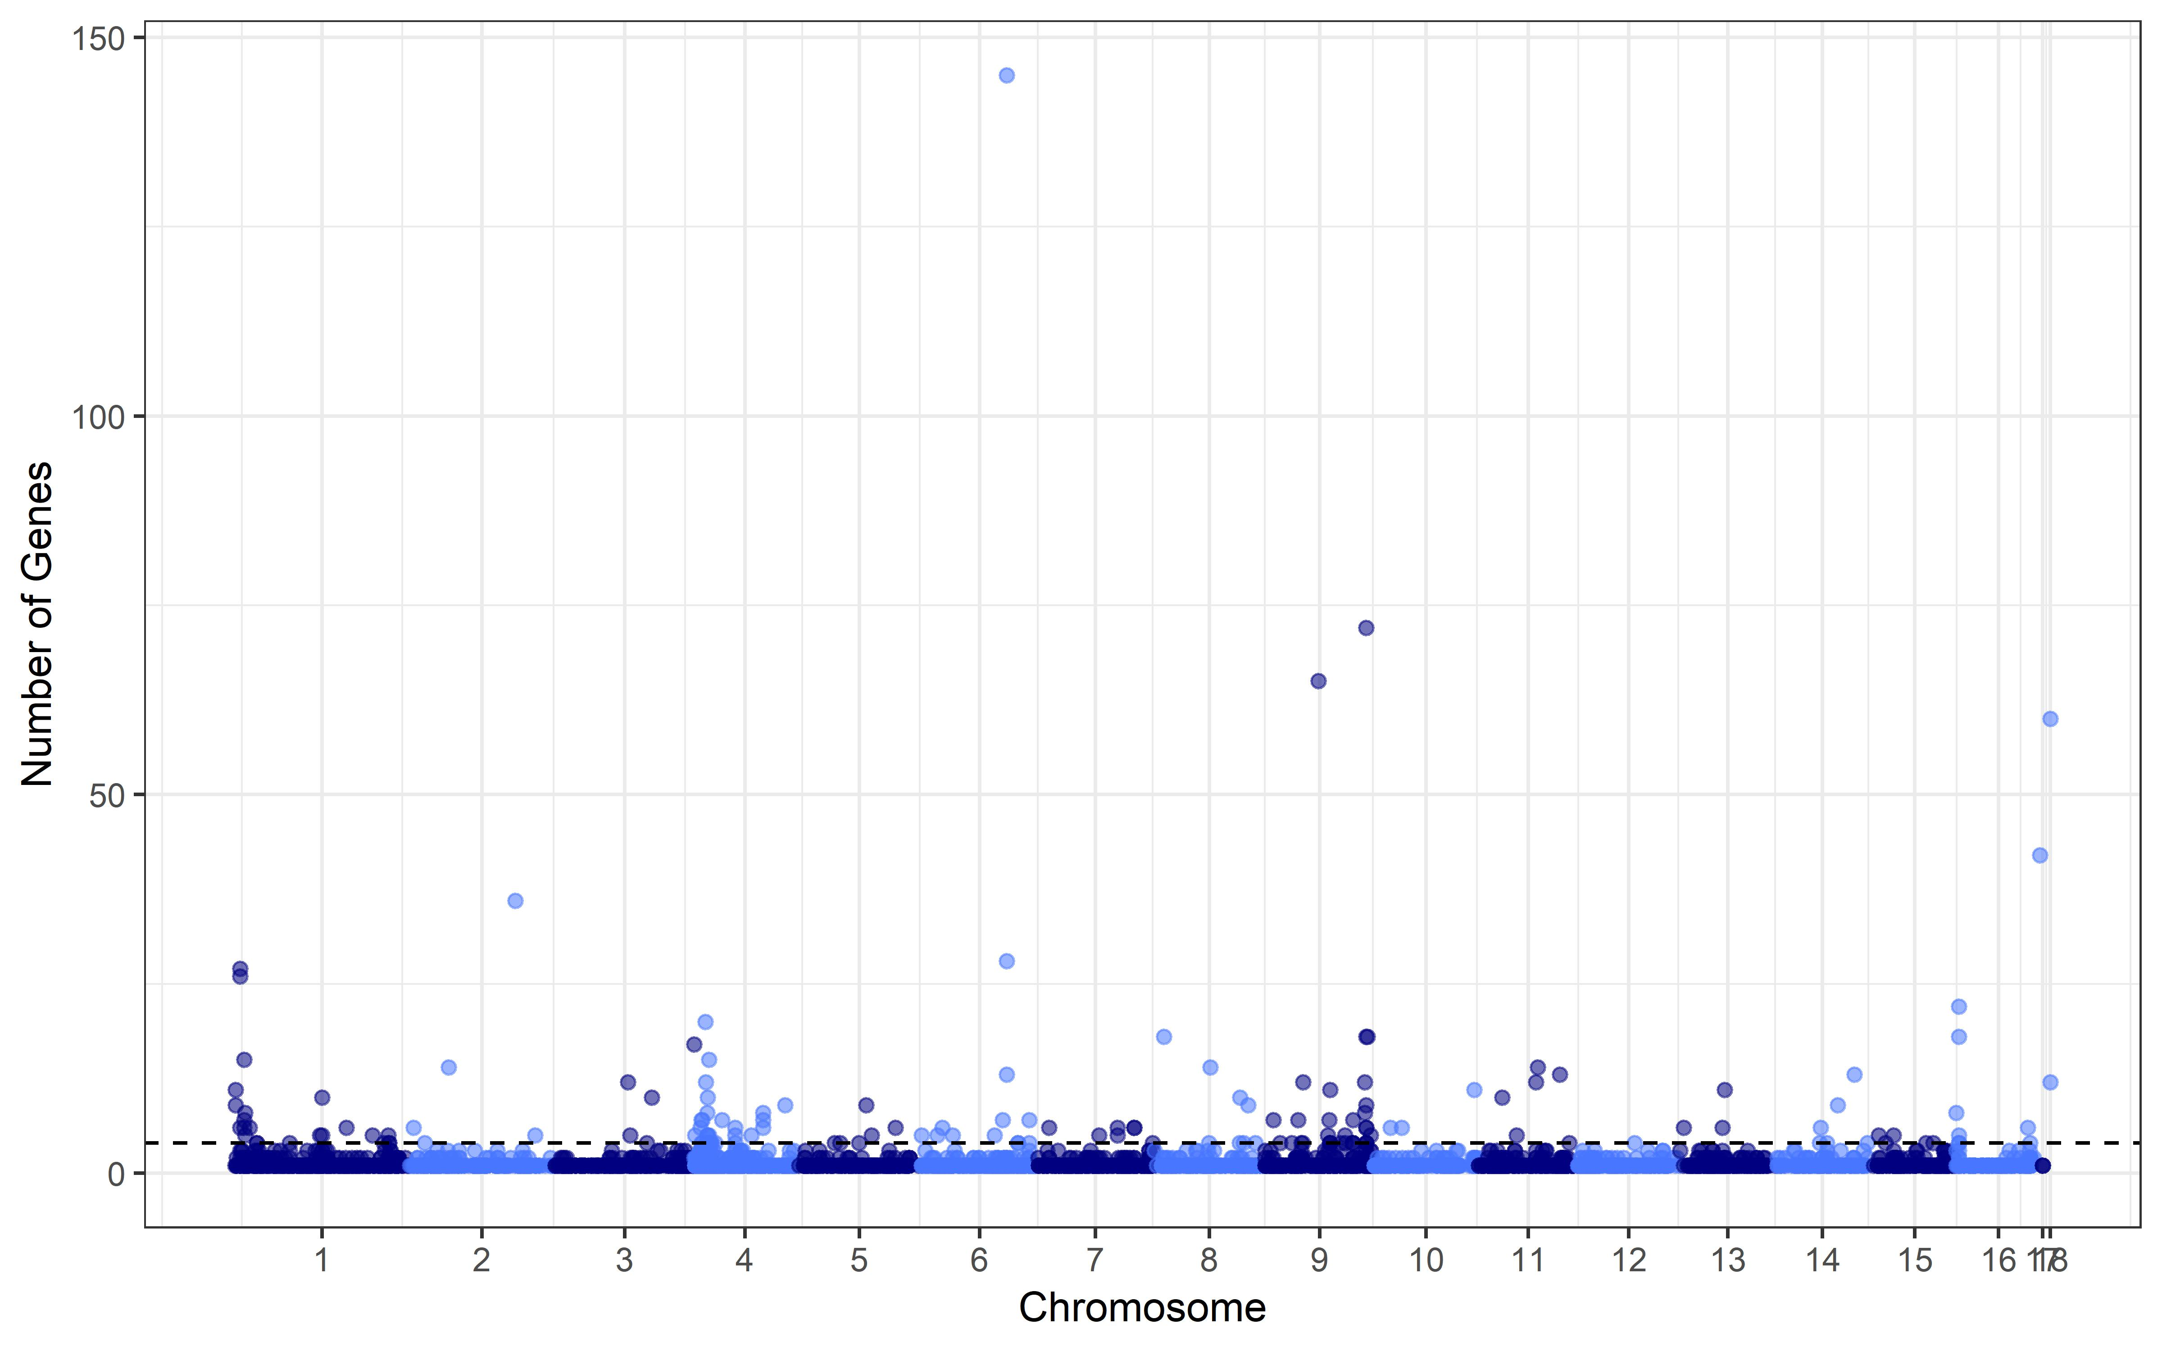
Botrytis eQTL hotspots > simulation threshold
Notes:
Add transition slide before At:
Fungal DNA → fungal transcription variation
Fungal DNA → plant transcription variation?

Slide 30
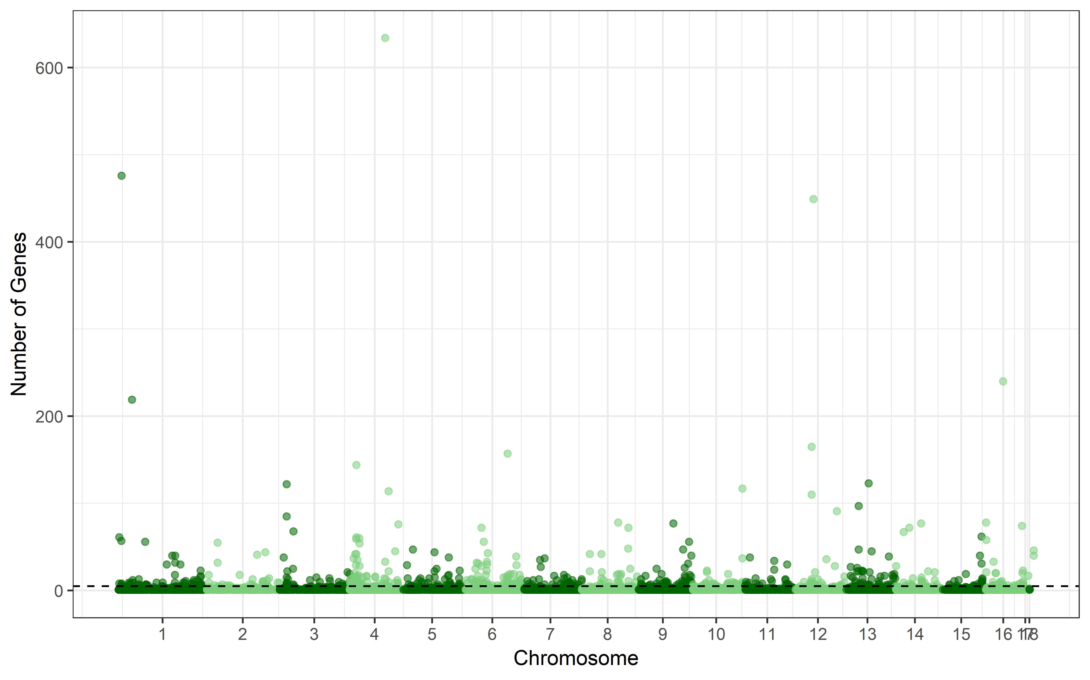
Arabidopsis eQTL hotspots > simulation threshold

Slide 31
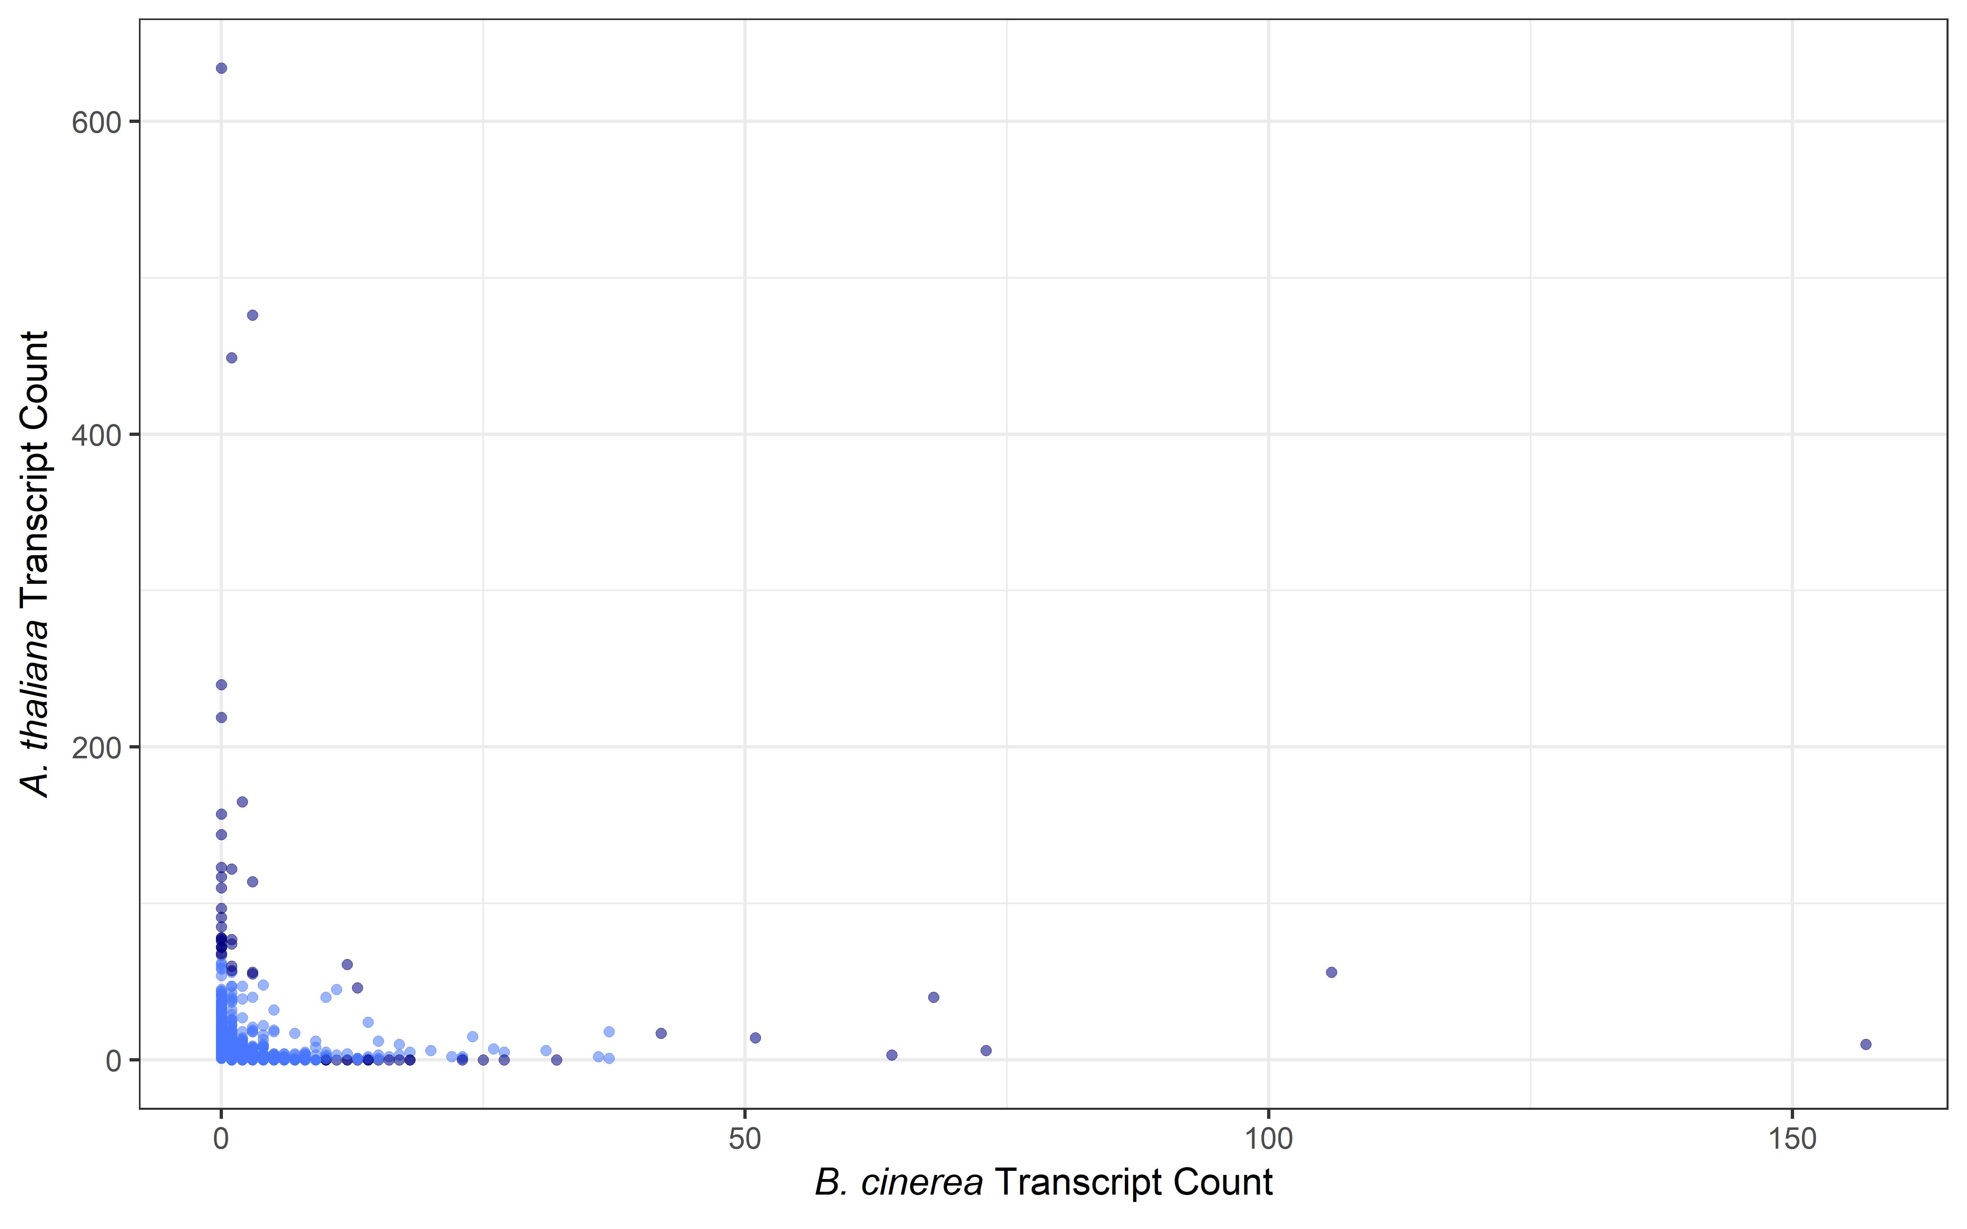
eQTL hotspot overlap: Arabidopsis and Botrytis
Notes:
Ellipse: joint species hotspot
Log-log to see center hotspots

Slide 32
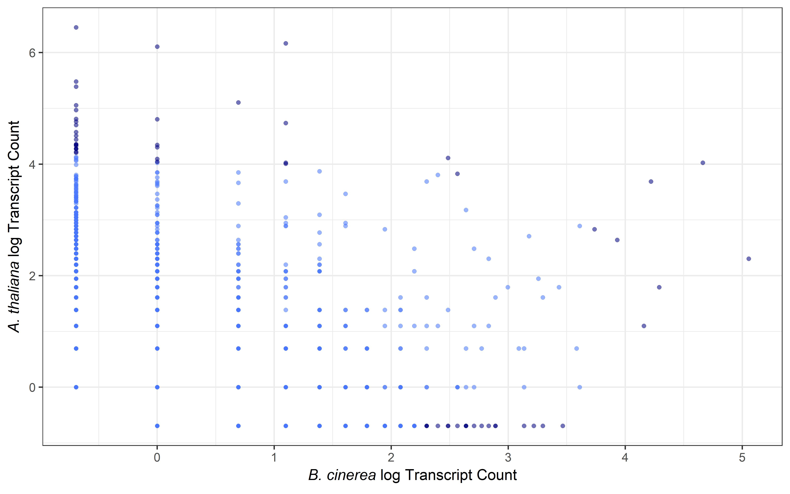
eQTL hotspot overlap: Arabidopsis and Botrytis
Notes:
ADD HERE: SNPs of interest annotated
THEN zoom in BOA
Plot manhattan BOA cluster: chunk of hotspots in cluster?

Slide 33
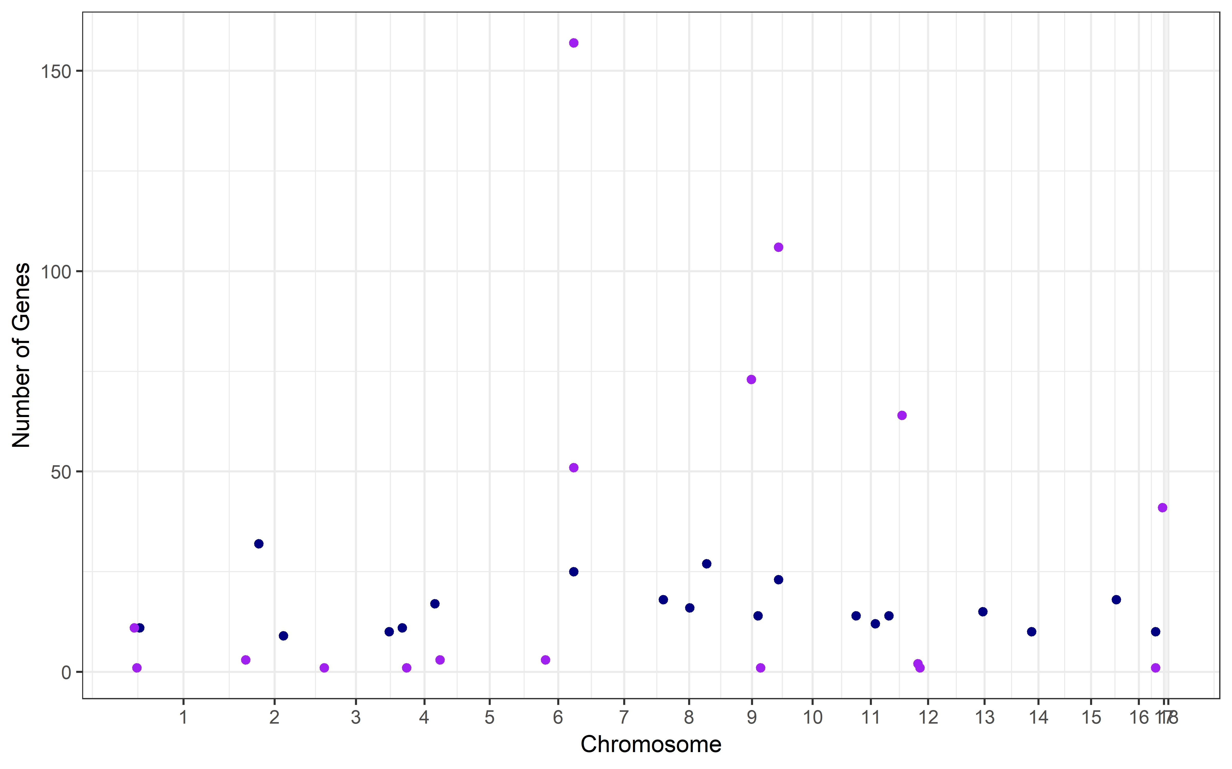
Selected genes at Botrytis eQTL hotspots
SNF2-related, helicase
BcBOA7: Botcynic acid biosynthesis
Cys6: transcription factor
Cytochrome p450
HHK5: signal transduction

Slide 34
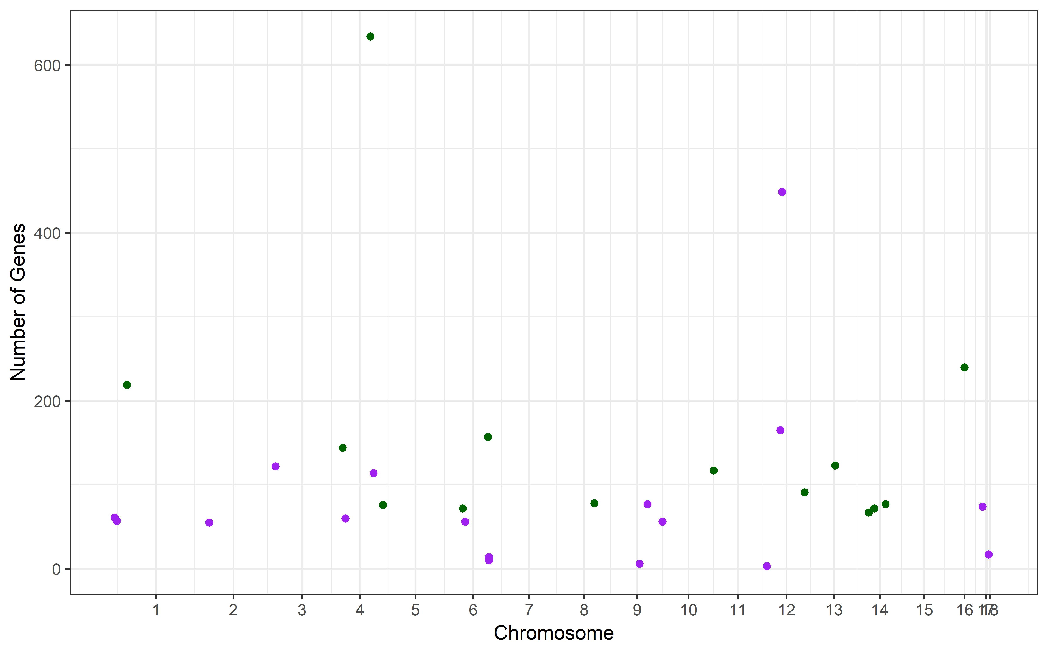
Selected genes at Arabidopsis eQTL hotspots
Heterokaryon incompatibility
NACHT
BcBOA7: Botcynic acid biosynthesis

Slide 35
BcBOA7 eQTL hotspot
BcBOA7: Botcynic acid biosynthesis

Slide 36
BcBOA7 eQTL hotspot: putative targets
Botrytis genes
Arabidopsis genes
13 linked
Bcin09g02390 (Bmp3): MAPK
Bcin15g01380: succinyl coA synthetase
62 linked
AT3G43440.1: jasmonate zim domain protein 11
AT1G08010: zinc finger TF
AT5G59460.1 (SCL11): scarecrow like TF
Notes:
Mitogen activated protein kinase: fungal virulence
Bmp3: plant surface sensing, KO decreases virulence
JAZ11: downstream jasmonate response
AT1G0810: slight Bc inducible
SCL11: not much B05.10
CONNECT to virulence. These are defense genes

Slide 37
Next Steps
1000x permutation of random Botrytis phenotypes
5x permutation of random Arabidopsis phenotypes
Annotate genes and functions at eQTL hotspots
Assess eQTL overlap with phenotypic candidate genes
eQTL analysis on additional Arabidopsis genotypes
coi-1
npr-1
Notes:
Replace: possible paths of causation
Bc gene expression → At expression…. CYCLIC between genomes?
Add analysis: lesion data. Are At high SNPs for lesion shared with trans hotspots list?

Slide 38


Thank you!
Kliebenstein Lab
Dr. Susanna Atwell
Dr. Celine Caseys
Dr. Ella Katz
Michelle Tang
Former Lab Members
Dr. Wei Zhang
Dr. Jason Corwin
Jastro Shields
Research Award

Slide 39
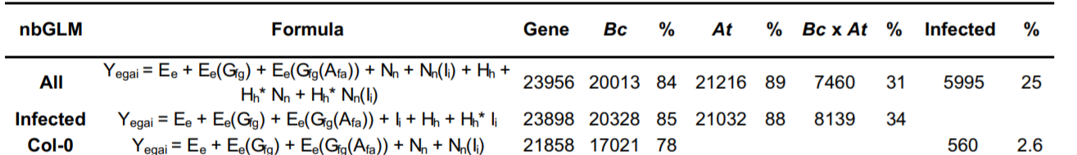
Linear model for transcript profiles
Y_{egai} = E_{e} + E_{e}(Gf_{g}) + E_{e}(Gf_{g}(Af_{a})) + I_{i} + H_{h} + H_{h}* I_{i}
Zhang et al. 2017, The Plant Cell

Slide 40
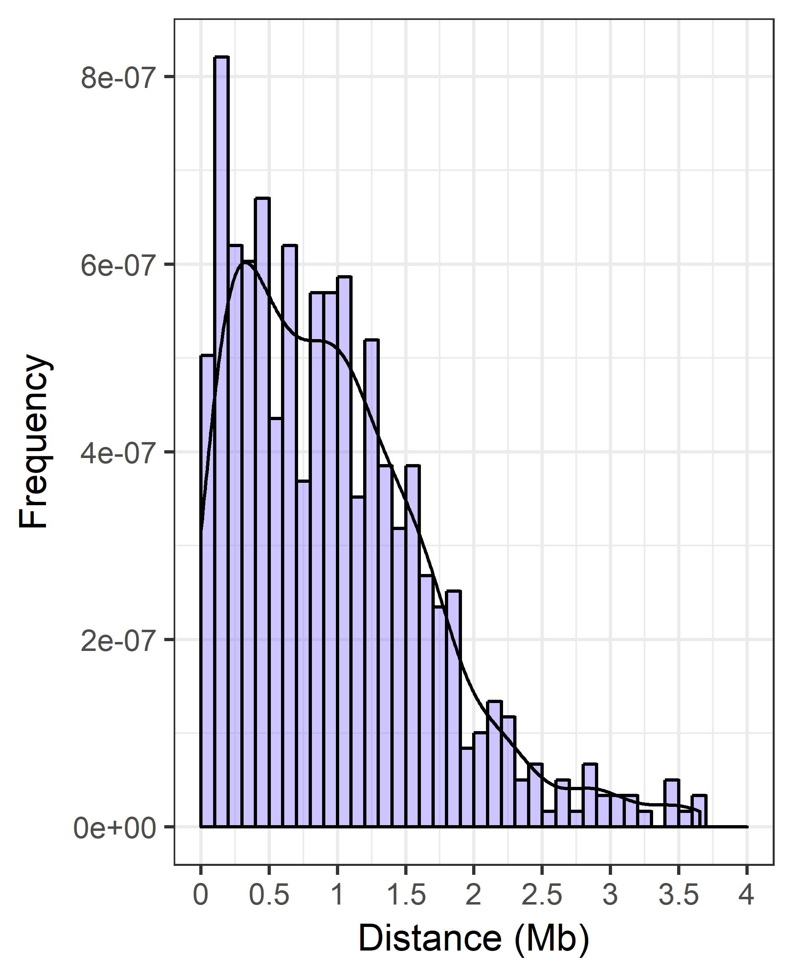
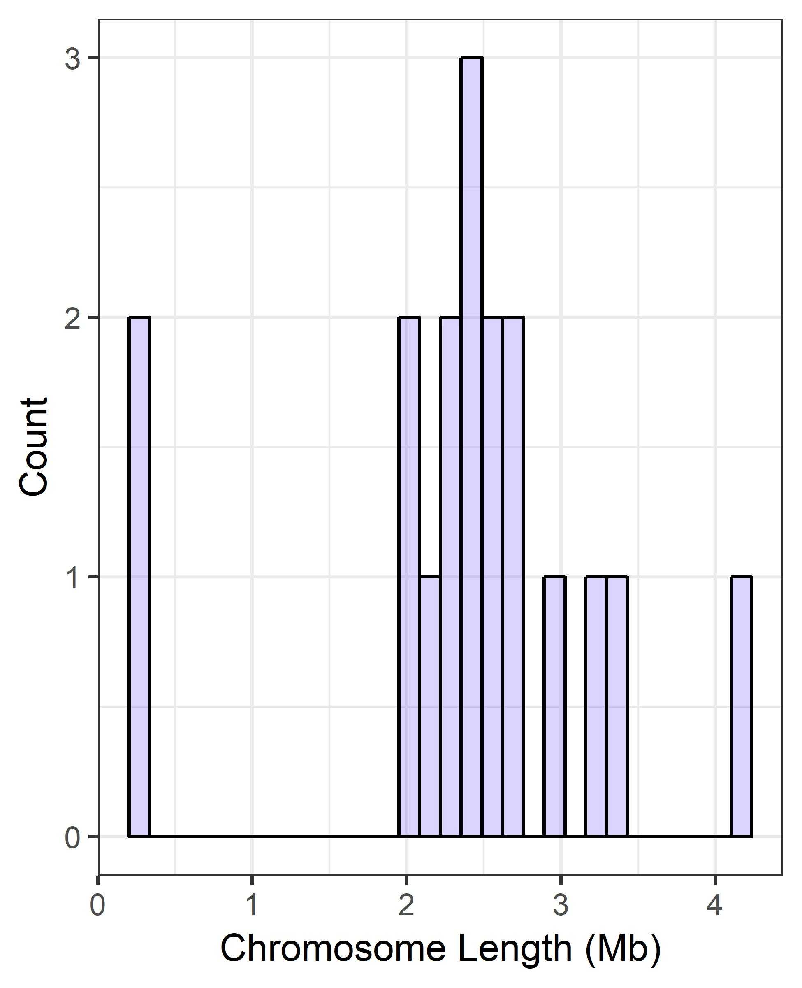
Lack of genome-wide cis-eQTL enrichment
Notes:
Delete. instead: Is there no cis or did we miss cis?

Slide 41
cis-acting loci may not be captured by SNP genotypes
SNP effect (BcBOA region)
BcBOA Gene
FDR-adjusted p(significant effect)
Cluster Membership
p < 0.001
p < 0.01
p < 0.05
Notes:
delete

